Slide 1
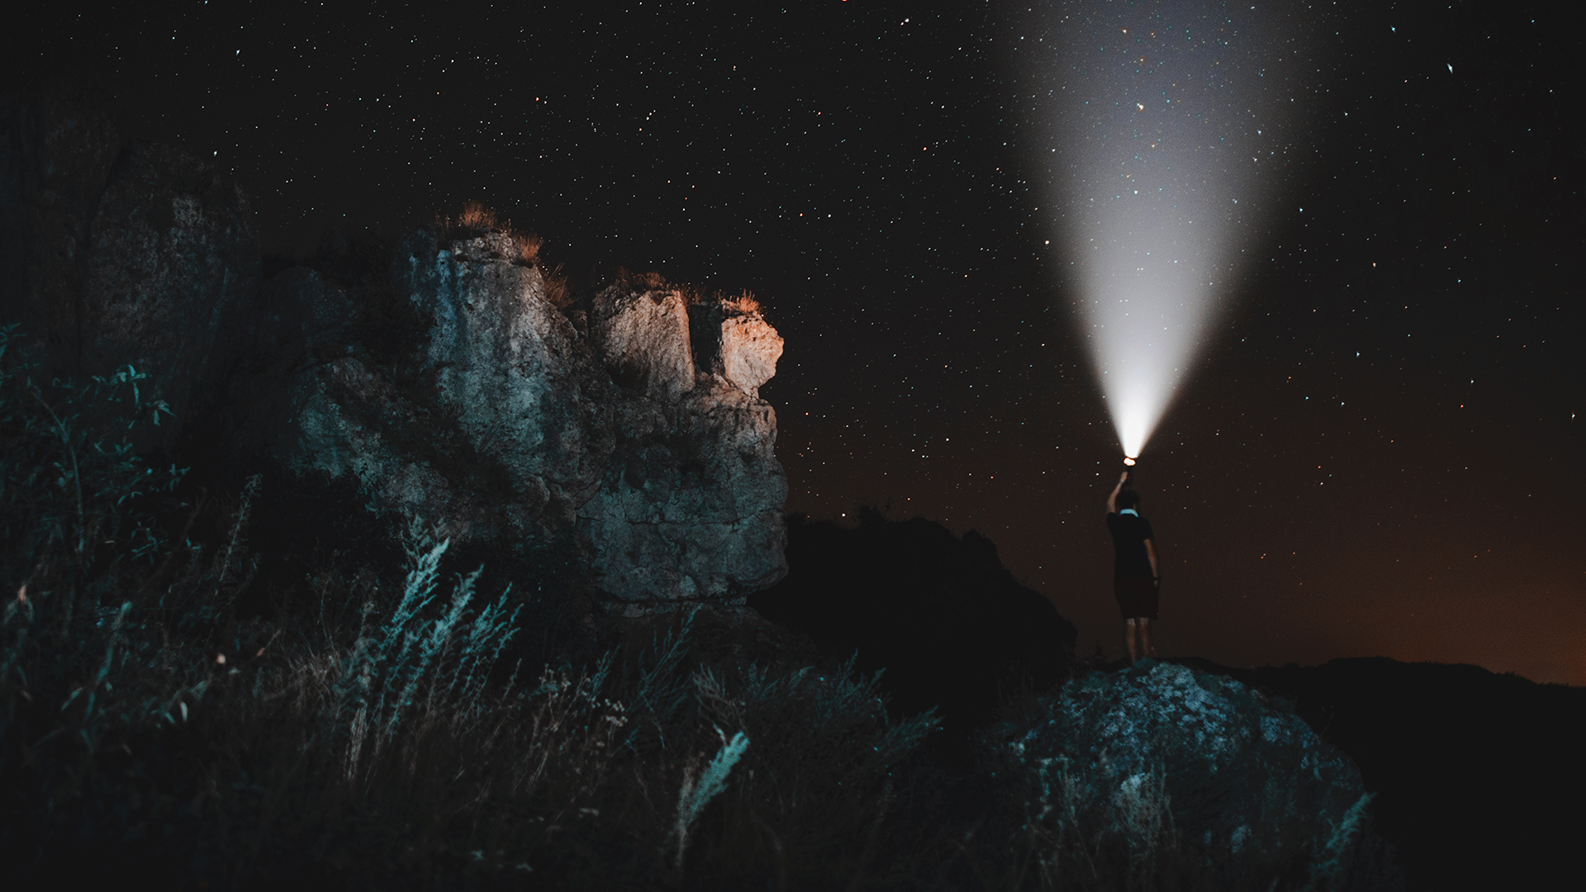
Astron-140 Portfolio
By Aidan Pierre-Louis

Slide 2
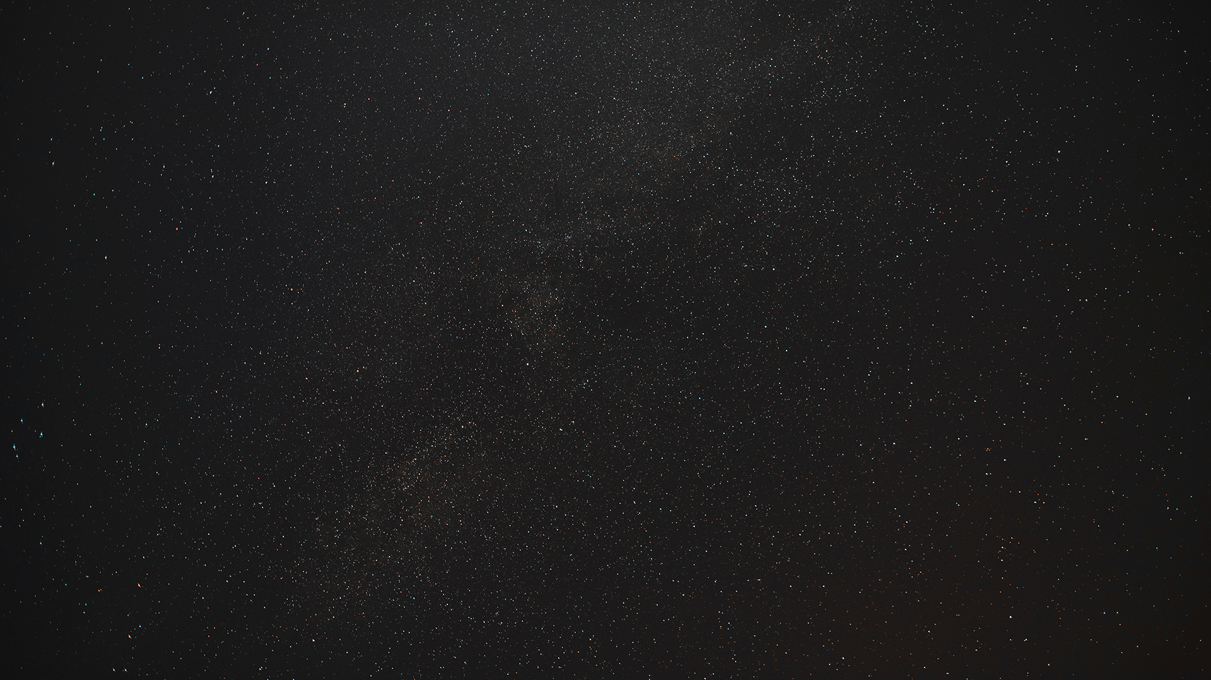
We call our planet ‘Fluffy’
But before explaining why that is, it is important to first understand the star it orbits.

Slide 3
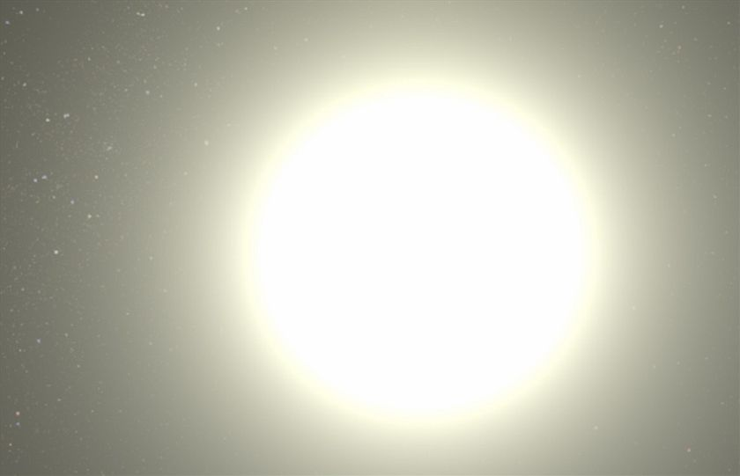
This is what I believe our star might look like. But why?
We were given these values for our star:
3.21 Solar Radii
1.54 Solar Mass
6161 degrees Kelvin surface temperature
Spectral class F
What do these numbers mean for our planet’s host star?

Slide 4
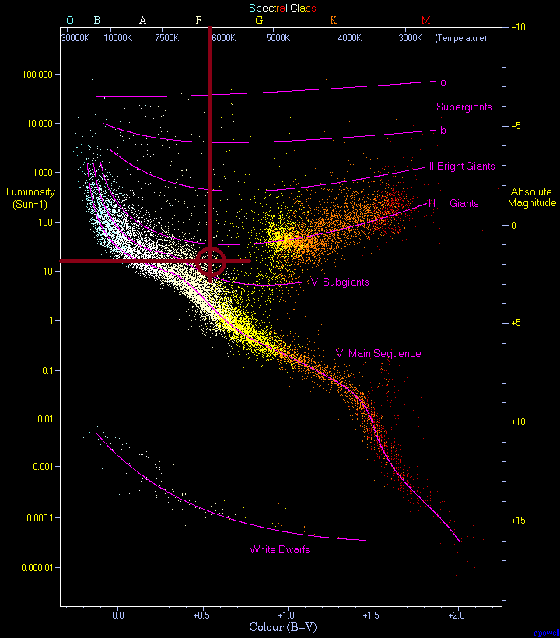
The Star on an HR Diagram
Because of Wien’s Law and we know that the star’s surface temperature is 6161K degrees, we can know the visible color of the star. On the Hertzsprung-Russell Diagram, a star of this temperature would also be spectral class F. Using a luminosity calculator with the values of our star’s radius and temperature pretty much confirmed that our star is not on the main sequence, but is actually a subgiant. This made is especially difficult to find values in simulators that assumed the star was main sequence.
Calculator used: https://www.omnicalculator.com/physics/luminosity

Slide 5
Planet’s Physical Properties
Planet Radius
Planet Mass
Surface Temperature
Albedo
Mean Density
0.215±0.2% R☉= 10⁻³±0.2% AU = 1.50*10⁵±0.2% km
Because the planet’s dayside temperature might likely exceed 2200 Kº, I think it is possible that there exists extreme weather conditions in its atmosphere magnitudes more intense than Jupiter, and perhaps the gases could glow like the surface of a star. Source: https://en.wikipedia.org/wiki/Hot_Jupiter
0.98±4.5% Jupiter Masses = 1.9*10²⁷±4.5% kg
1580±33.7% Kº
0.3±0.1
0.1323±5.1% gcm⁻¹

Slide 6
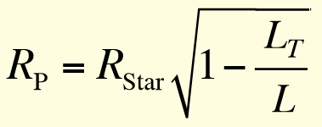
How did we get our planetary radius?
The Equation
Variables
Uncertainty
Justification
We used the equation provided from lecture.
(L variables are Normalized Flux values, where T stands for transiting)
By plugging in variables we got from our data, we were able to calculate a planetary radius. R_{Star} = 3.21 R☉ L_{T} = 0.9955±0.001 L = 1.0000±0.001
Because the Star radius was a given value without an uncertainty, we assumed it to be negligible. Because L_{T} and L were divided, we took the sum of their absolute uncertainties which is 0.2%. This total abs uncertainty is the uncertainty for the planet radius value.
A radius of 0.215 R☉ is not impossibly big, since Jupiter is a jovian around 0.1R☉. The uncertainty is also relatively small, so it gives us confidence in the accuracy as well as the precision of the value since the Flux values were obtained from a beautifully phase-folded light curve.

Slide 7
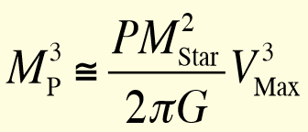
How did we get our planetary mass?
The Equation
Variables
Uncertainty
Justification
We used the equation provided from lecture.
(G is the gravitational constant)
By plugging in variables we got from our data, we were able to calculate a planetary mass. P=0.0236±0.0001 years M_{Star}= 1.54 M☉ V_{Max}= 73±1ms⁻¹ G=6.674*10⁻¹¹m³kg⁻¹s⁻²
Because the Star mass was a given value without an uncertainty, we assumed it to be negligible. Because M_{Star} was squared, V_{max} was cubed, and they were all multiplied together, I took the sum of 1*(abs uncertainty P) + 2*(abs uncertainty M_{S}) + 3*(abs uncertainty V_{max}) to get the final abs uncertainty of 4.5% for M_{P}.
A mass of 0.98 M_{J} seemed a bit small for its radius, but we talked with Francisco and he also thought it seemed reasonable. The uncertainty is also relatively small, so it gives us confidence in the accuracy as well as the precision of the value since the velocity max value was obtained from phase-folded radial velocity curve.

Slide 8
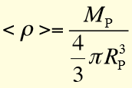
How did we get our planetary density?
The Equation
Variables
Uncertainty
Justification
We used the equation provided from lecture.
By plugging in variables we got from our calculations, we were able to calculate a planetary mass. M_{P}=1.9*10³⁰±4.2% g R_{P}=1.50*10¹⁰±0.2% cm
Because M_{P} was divided by R_{P}, which was cubed, I took the sum of their the abs uncertainty for M_{P} + 3*(abs uncertainty of R_{P}) to get the final abs uncertainty of 5.1% for p.
A density of 0.1323gcm⁻¹ seemed extraordinarily not dense, since jovians in our solar system are around 1gcm⁻¹. The uncertainty is also relatively small, so it gives us confidence in the precision but the accuracy is hard to discern. We searched for other planets that have been discovered with extremely low densities, though, and they share many the same properties to our planet.

Slide 9
0.3 Albedo
Because of the extraordinarily low density of our planet, we found difficulty in determining an albedo for it. We began researching other ‘puffy’ planets we could find to get an idea of our own planets albedo. We compared the physical and orbital properties of our planet to ones like HAT-P-1b, COROT-1b, WASP-12b, WASP-17b, WASP-174b, and Kepler-7b to try and scrutinize their albedos.
Some had albedos as low as <0.1 and others around the albedo of Jupiter and Saturn (0.5). We settled on 0.3 since most planets with really close densities to ours were around 0.3 without much deviation.
We decided on an arbitrary uncertainty of 0.1, sacrificing much of our albedo’s precision in favor of accuracy so that others who interpret our data are not mislead by some false confidence in the value.

Slide 10
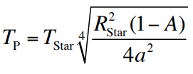
How did we get our planet’s surface temperature?
The Equation
Variables
Uncertainty
Justification
We used the equation provided from lecture.
By plugging in variables we got from our data, we were able to calculate a planetary surface temp. T_{Star}=6161K R_{Star}=1.49*10⁻² AU A = 0.3 (albedo) a= 0.0949 AU (semimajor axis to star)
Because the Star’s radius and surface temp were given values without uncertainty, we assumed them to be negligible. Because R_{Star} was squared, ‘a’ was squared, and they were all multiplied together, I took the sum of (abs uncertainty T_{S}) + 2*(abs uncertainty R_{S}) + 2*(abs uncertainty ‘a’) + (abs uncertainty A) to get the final abs uncertainty of 33.7% for M_{P}.
A surface temperature of hot jovians is typical to be in the magnitudes of thousands of degrees Kelvin, which reassures me in the accuracy of this measurement. The precision is lacking since our albedo is so uncertain, so we may very well be off by hundreds of degrees kelvin, especially since the dayside and nightside temperatures of the planet’s surface will vary at this semi-major axis.

Slide 11
Planet’s Orbital Properties
Period: 8.60±0.01 days ~= 0.0236±0.0001 years
Semi-Major Axis: 0.0949±0.4% AU
Radial Velocity Max: 73.0±1.0 ms⁻¹
Eccentricity: 0.015±0.05
Our planet has an almost uniform circular orbit less than a tenth of an AU away from its host star. Because of this, as well as the physical properties we found for it, we believe it to be a ‘puffy’ hot Jupiter. Because it is so close to its host star, and is so massive, it has a relatively large pull on the star in the tens of meters per second.
Because the star is so large and the planet is so close, it is also possible that there may be observable “Star-Planet Interactions”.
Source: https://en.wikipedia.org/wiki/Hot_Jupiter

Slide 12
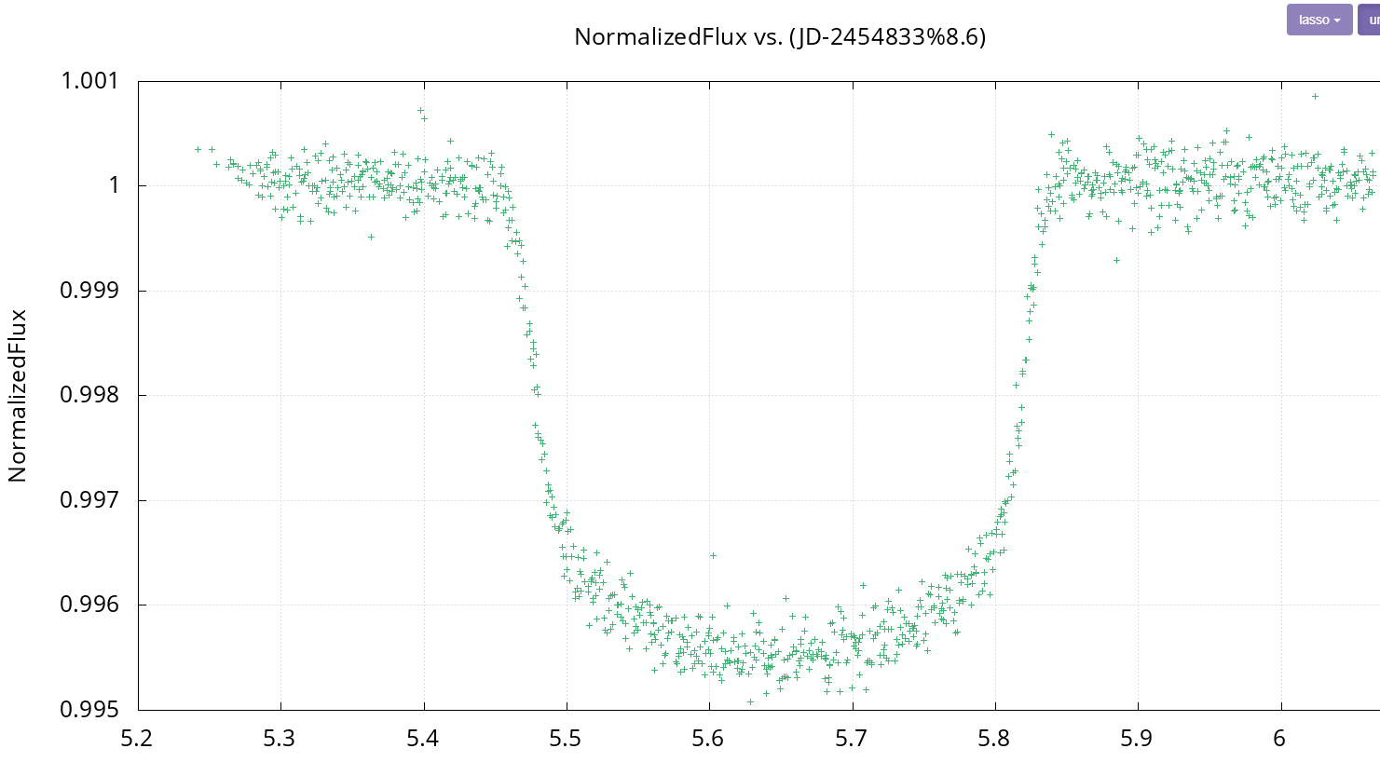
How did we get our Planet’s Orbital Period?
Through many attempts to find a pattern through phase-folding our group’s light curve data, we came upon a phase-folded graph (left figure) that would represent our planet’s transit. It also seems to have a transiting length of almost 0.4 days.
Because of our confidence in the accuracy of the period because of the shape of the transit as well as the precision of the instrument’s data, I applied an uncertainty of 0.01 days.

Slide 13
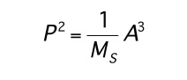
How did we get our planet’s Semi-Major Axis?
The Equation
Variables
Uncertainty
Justification
We used the equation provided from lecture, where A is semi-major axis.
By plugging in variables we got from our data, we were able to calculate a planetary surface temp. P=0.0236±0.0001 years M_{s}=1.54 M☉
Because the stars mass was given without an uncertainty, it was assumed to be negligible. Because P was squared and they were all multiplied together, I took the sum of 2*(abs uncertainty P) to get the final abs uncertainty of 0.4% for A.
A semi-major axis of 0.0949 AU is reasonable since hot jovians are typically near their stars like our planet, since the transit detection method has a bias for hot jovians. The uncertainty is also relatively small, so it gives us confidence in the accuracy as well as the precision of the value since the period value was obtained from a phase-folded light curve.

Slide 14
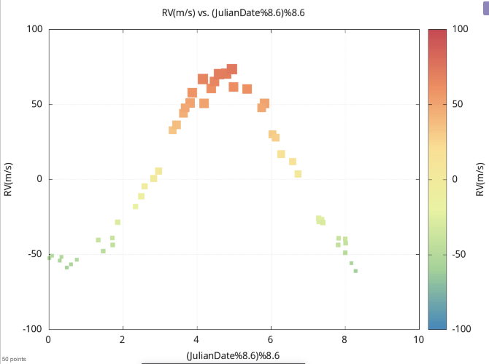
How did we get our planet’s radial velocity max? Eccentricity?
The value for the radial velocity max was obtained from the curve’s maximum point determined to be about 73.0 ms⁻¹ on filtergraph. Because of the variation in the points resulting from the measuring instruments slight imprecision, an uncertainty of 1.0 ms⁻¹ was chosen. By using the simulator from class to compare the shape of our curve to, we found the eccentricity to be somewhere in between the bounds of 0.01 to 0.02. So, we decided on an uncertainty of 0.005 with a value of 0.015.

Slide 15
What is our planet composed of?
~95% Hydrogen
+ ~<5% Helium
+ <1% Other elements(ex. Ammonia, Metals near core, etc)
The planet is jovian so it would not have a traditional surface which could be landed on, but rather would be an atmosphere which gets denser the further down one travels.
Because of this, nearer the core, the high pressure would cause the hydrogen to behave like a metal, perhaps giving the planet an electromagnetic field. It’s low density may be attributed to the fact that it is superheated by its star.
Because our planet is a unique type of ‘puffy’ hot Jupiter with a much lower density, likely having much more lighter gases, primarily Hydrogen, than any other elements, even compared to other jovians.
Above is a possible combination of elements with a mean density of about 0.13 gcm⁻¹.

Slide 16
How might our planet have originated?
The planet may have grown traditionally by sticking together as space dust at first, then collisions into a small rocky planetoid, finally accreting gases with its immense mass. Then the planet would have migrated inward due to possible disturbances in gravitational pull or by some highly eccentric orbit which stabilized near the star. This would explain the phenomena of the really small semi-major axis.Source: https://en.wikipedia.org/wiki/Hot_Jupiter
The second possible scenario is the in situ hypothesis. This is where the planet started off as a rock ‘super-earth,’ colliding with and stick to other potential planets which may have crossed orbits or migrated to it to create a core large enough to accrete the gases near the center of the system the star did not accrete. This would require the planet to have had a really low eccentricity orbit and develop a massive enough core to attract gases. This would explain the phenomena of the really low density, perhaps. Source: https://en.wikipedia.org/wiki/Hot_Jupiter

Slide 17

What about the planet’s habitability?
The planet is jovian so it would not have a traditional surface which could be landed on, making it virtually impossible to live on the planet’s surface.
What about a ‘Star Wars Esque cloud city’. If there could be a method engineered that would block out the intense light from the host star, we may be able to inhabit it. Because of its size and low density, it likely is not massive enough to exert a large gravitational force near its surface either.
Would it be possible to live on its moon(s)? If the planet had moons, which is highly unlikely for Hot Jupiters (Source: https://en.wikipedia.org/wiki/Hot_Jupiter), and those moons were tidally locked, it may be possible to live on parts of those moons, given they are Earth-mass, where it is shaded from the star permanently, and is cool enough for liquid water to exist without sublimating.
Alien life may be impossible because of the extremely low density especially near the surface and intense heat.

Slide 18
Thank you, Fin

